Slide 1
G-DLD in AWS cloud platform
For serverless applications

Slide 2
Data Leakage Introduction
Data leakage is a common problem in databases and cloud applications, that involves data from a private source getting exposed.
It is a significant concern for organizations that rely on serverless computing as it can lead to reputational damage, legal consequences, and financial losses.
So far, there is no real solution for detection, only best-practice for prevention.

Slide 3
Research Question
Can we detect data leakage generically in serverless applications?
How long it would take to discover a data leakage if such event happens?
What are the signs of data leakage in serverless application?
Who is most likely to be the culprit, an insider or outsider?

Slide 4
Research Goal
Detection of data leakage generically in the serverless environment of the AWS cloud.

Slide 5
Related Work
Amazon GuardDuty: Amazon GuardDuty is a threat detection service that uses machine learning to identify and alert you to potential security threats in your AWS environment.

Slide 6
Data Leakage Prevention
DLP Methods:
Access Control and Auditing: Access control and auditing mechanisms can be used to monitor and track user activity within the cloud environment, including access to sensitive data. This can help detect any unauthorized attempts to access or download sensitive data.
Encryption: Encryption can be used to protect sensitive data from being read or accessed by unauthorized users. By encrypting data at rest and in transit, data leakage can be prevented or minimized.
Network Traffic Analysis: Network traffic analysis tools can be used to monitor network traffic and identify any suspicious data transfers or patterns that may indicate data leakage.
Behavioral Analysis: Behavioral analysis tools can be used to monitor user behavior and detect any unusual activity that may indicate data leakage. This can include monitoring login attempts, file access, and data transfers.

Slide 7
Vulnerabilities – function focus
Function attacks: function parameters being exploited
Operating System (OS) command injection
Function runtime code injection (e.g. Node.js/JavaScript, Python, Java, C#, Golang)
SQL/ NoSQL injection
Pub/Sub Message Data Tampering (e.g. MQTT data injection)
Object deserialization attacks
XML External Entity (XXE)
Server-Side Request Forgery (SSRF)

Slide 8
Vulnerabilities – policy focus
Broken authentication: exploit open API’s, public access storages, or general external resources. (For example, the execution of internal functionality without authentication is possible if a function is triggered by administrative emails)

Slide 9
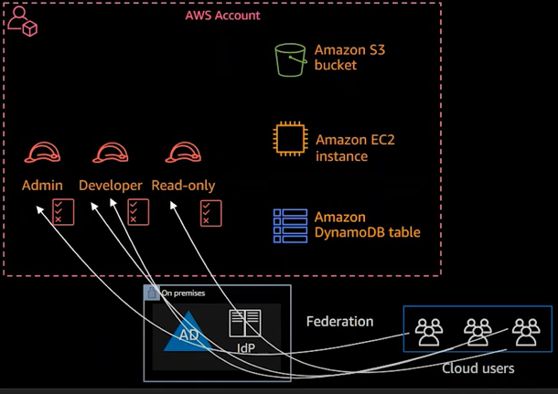
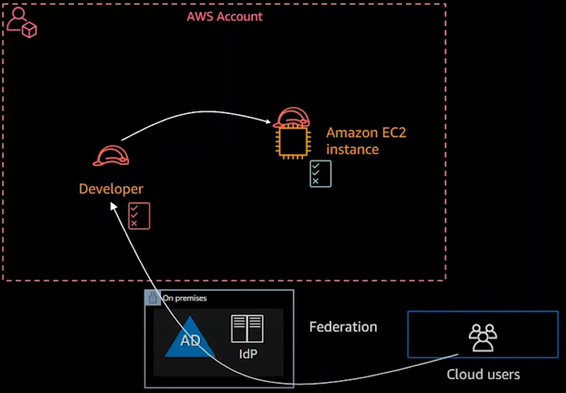
AWS Security and access
Human permissions
Machine permissions

Slide 10
AWS Security and access - Policy
{
"Version": "2012-10-17",
"Id": "ExamplePolicy01",
"Statement": [
{
"Sid": "ExampleStatement01",
"Effect": "Allow",
"Principal": {
"AWS": "arn:aws:iam::123456789012:user/Dave"
},
"Action": [
"s3:GetObject",
"s3:GetBucketLocation",
"s3:ListBucket"
],
"Resource": [
"arn:aws:s3:::awsexamplebucket1/*",
"arn:aws:s3:::awsexamplebucket?/"
]
}
]
}
A S3 policy for an example- notice how the user is the object and the bucket is the subject of the permissions.
Effect: what mode (allow/deny)
Principal: who\what get the policy
Action: what operations are affected. (all permissions are implicitly denied by default)
Resource: on what the operations could be used

Slide 11
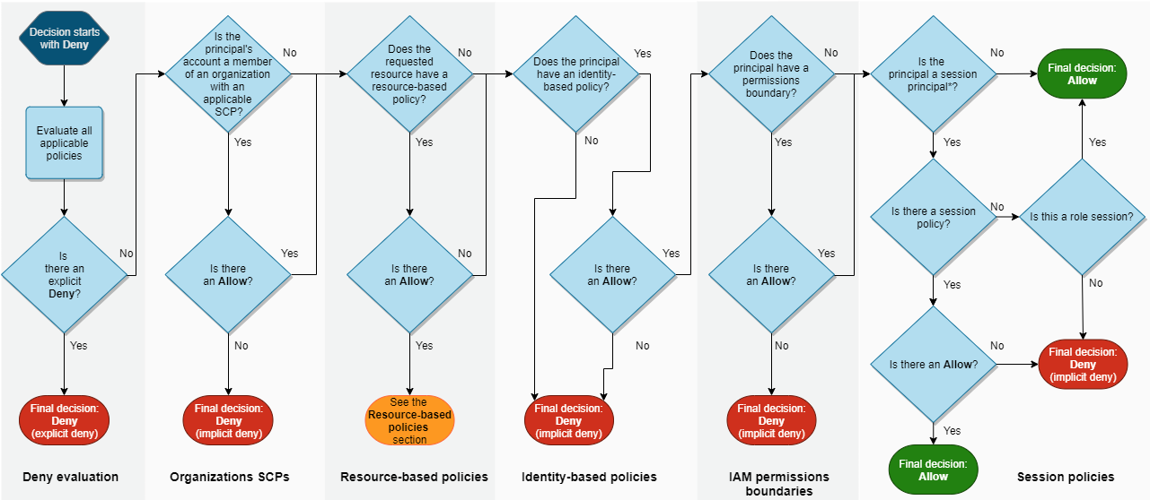
AWS Security and access – Policy Logic

Slide 12
Work Pipeline
The logs collected from the simulation are done by executing a series of experiments.
We create two datasets, one from the lambda side, and one from the storage side.
We create a graph based on users and resources in a time window and check the permissions at each timeframe.
The model would detect DL at a new environment without the need for additional pre-training.
1. Data collection
2. Import and Parsing
3. Preprocessing
4. Model

Slide 13
Challenges
There is a problem with matching lambda logs with storage logs, as they are showing different actions in the same workflow.
Too many features in a graph may be too messy.

Slide 14
Proposed Methods – Graph Edges
Each edge represents a relation between resources, the specific action is labeled on top of each edge.
We can atomize the resources into:
Lambda class(role)
S3 bucket directory/file(policy)
DynamoDB specific attribute(policy)
We filtered time windows with low traffic[100<] as to get a comprehensive graph
Source | Target (S3 / DynamoDB) | Operation | Access Type (read / write) | Operation Count (same operation acted on target node) | Sample Time

Slide 15
Proposed Methods – Graph Nodes
Each node represents the permission policy of each role.
We filtered time windows with low traffic[100<] as to get a comprehensive graph
Role Name | Resource Permissions | Operations Permissions | Permission Type (Allow/Deny) | Access Type (read / write) | Sample Time

Slide 16
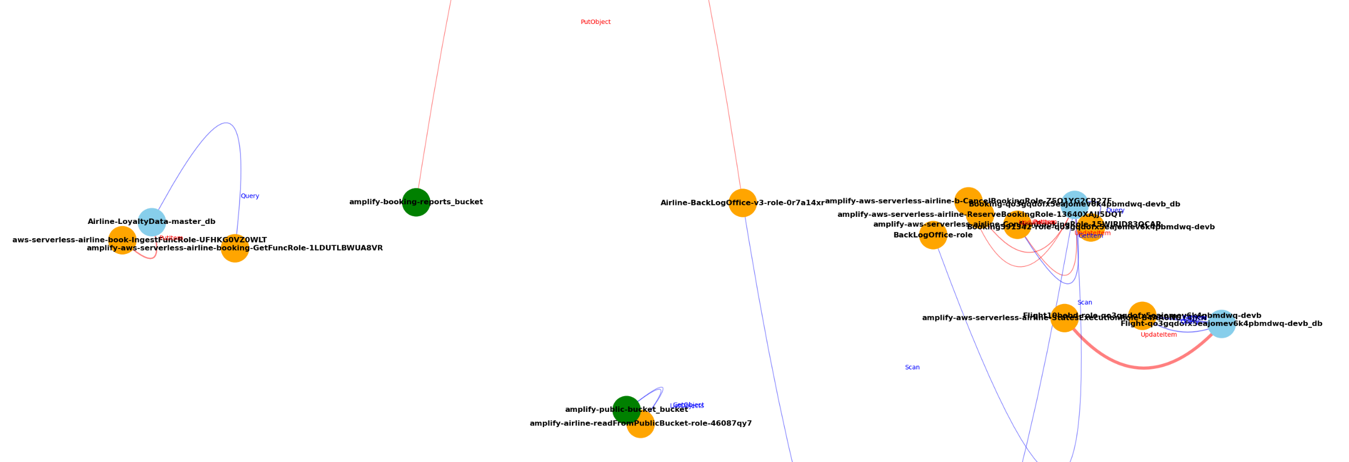
Normal activity – Back office lambda put item in reports bucket

Slide 17
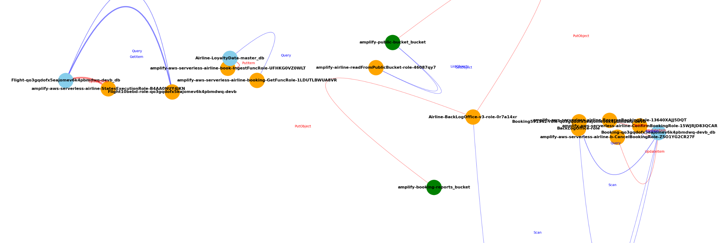
Anomalous action – Back office lambda put something in public bucket

Slide 18
Proposed Methods – Additional features
Errors: access denied, error codes, etc…
Bytes transferred and direction(extracted data or inserted data)
VPC
IP and user agent, depends on level of infiltration
Policy context and initiator of change
Specific policy changes
Statistics for lambda class in a time window
Permission matrix inside nodes for higher resolution

Slide 19
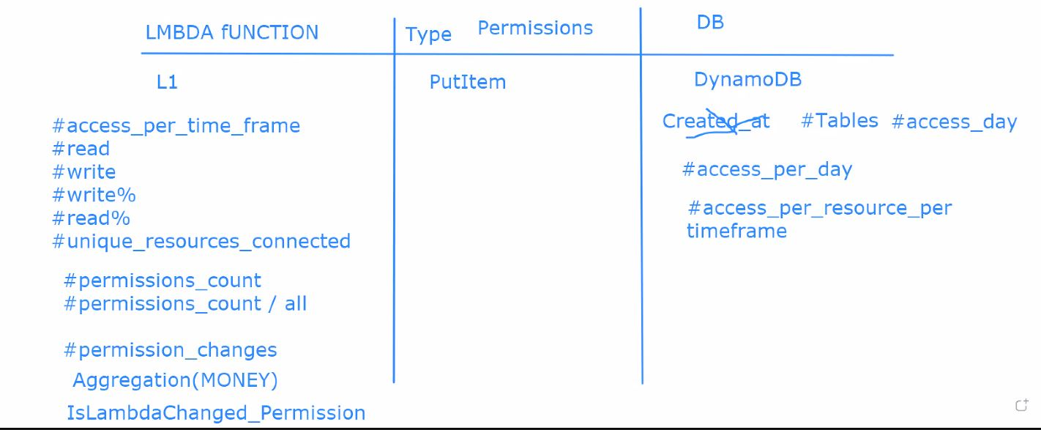
Proposed Methods

Slide 20
Proposed Methods
Create 8 dimensional vectors. (might need more/parsing)
Create mathematical representation of the vector. (labeling / text to math)
Create vector space clustering. (drawback: need to run for some time / based on history)
Detect anomalies by fine-tuning a network . (not consolidated)

Slide 21
Expected Results
The graph shows the differences in permissions that the model would be able to spot and detect the anomalous actions for resources at the same timeframes.
We are using data that focus on the policies, in order to understand better the operation space of an entity, as we assume correct configuration at the start, anomalous actions would stand out, especially for public access sources.

